Slide 1
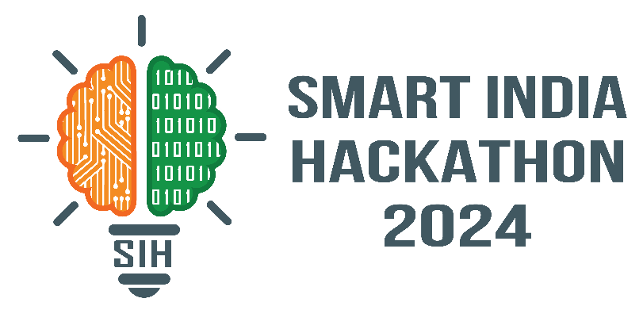

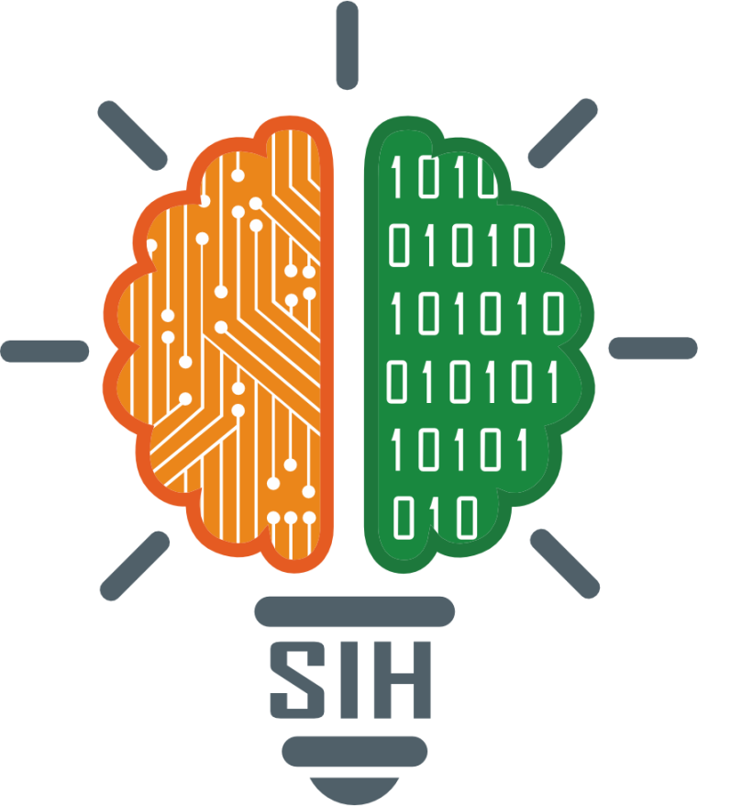

SMART INDIA HACKATHON 2024
Problem Statement ID – 1631
Problem Statement Title- AI-Powered Student Assistance Chatbot for Department of Technical Education, Government of Rajasthan.
Theme- Smart Education
PS Category- Software
Team ID-
Team Name (Registered on portal)- Team Proton

Slide 2
PROPOSED SOLUTION
Team Proton
OVERVIEW
Used Llama LLM to create AI-assistance for university related issues.
It uses NLP to answer wide range of queries.
INNOVATION AND UNIQUENESS
Integration with Local Systems: Llama LLM chatbot integrate seamlessly with any websites and can be run on any server with required compute.
Real-Time Updates: uses latest information from college databases.
Self maintained: updates in database keeps chatbot updated.
Cost-effective: made using open source LLm’s that is free of cost.

Slide 3
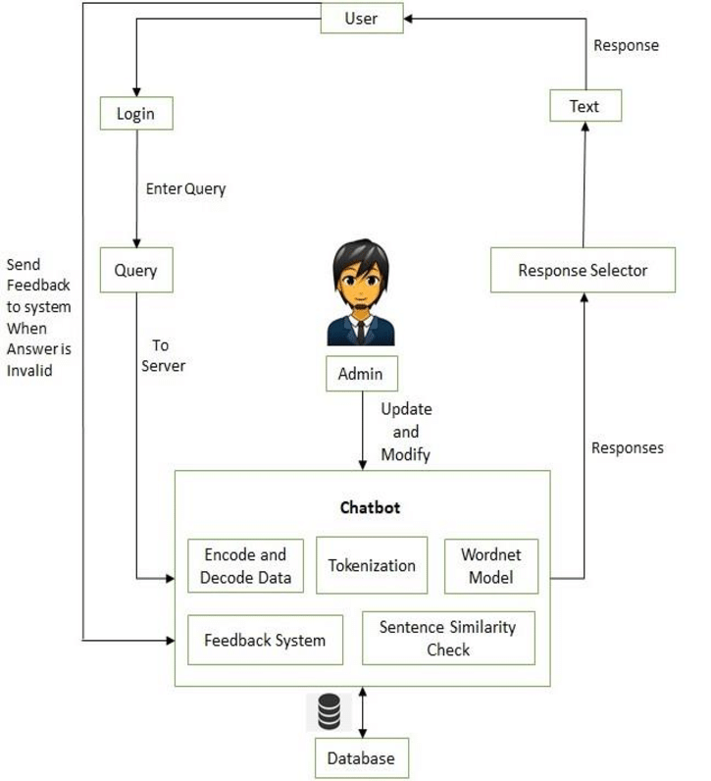
TECHNICAL APPROACH
Team Proton
Technologies to Be Used:
Programming Languages: Python
Hardware: Intel core i7, Nvidia RTX4060 GPU, 16 GB RAM
Databases: MySQL, MongoDB
Cloud: AWS

Slide 4
FEASIBILITY AND VIABILITY
Team Proton
Feasibility Analysis:
Technical: Advanced tools will be available; integration is manageable.
Financial: Costs include development and maintenance; near to no cost idea.
Operational: User-friendly design aids adoption; ongoing support needed.
Potential Challenges and Risks:
Technical: Data availability, accuracy of LLM.
Financial: Paid LLM’s for better responses, availability of powerful compute instance.
Strategies:
Technical: data collection from FAQ’s further integrable with college dataset, improving LLM accuracy using thorough testing and debugging.
Financial: using free open source llama 3.1, minimum hardware requirement solution.

Slide 5
IMPACT AND BENEFITS
Team Proton
Potential Impact:
Target Audience: The chatbot offers students, parents, and stakeholders quick, accurate responses about admissions and related queries, improving overall user experience and reducing the need for manual follow-ups.
Benefits:
Social: Improves accessibility to information, supports informed decision-making, and ensures 24/7 assistance.
Economic: Cuts administrative costs by automating responses, streamlines processes, and frees up staff for more complex tasks.
Environmental: Reduces the reliance on physical documentation and travel, contributing to lower paper use and a smaller carbon footprint.

Slide 6
RESEARCH AND REFERENCES
Team Proton
Chatbot Technologies: Llama 3.1
NLP: SpaCy, Hugging Face
Databases: MySQL, MongoDB
Cloud Services: AWS
Research:

